Slide 1
EndTest Data Entry
By: Austin Ibele

Slide 2
Overview
Software
Program Structure
Changing Preset Specifications
Adding on later

Slide 3
Software used
PyCharm 2018.3 Community edition IDE (for development)
Python 3.7
With the following additional packages: pandas numpy
xlrd pdfrw openpyxl
To install packages
Use ‘pip install’
https://github.com/BurntSushi/nfldb/wiki/Python-&-pip-Windows-installation
https://stackoverflow.com/questions/29817447/how-to-run-pip-commands-from-cmd
Python 37 and ALL PACKAGES are necessary for program to run

Slide 4
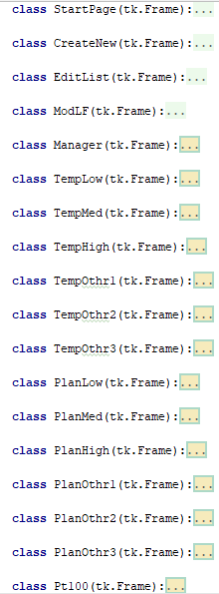
Program Structure
Layout for each page is contained
Inside a class
Most functions called from a page
are inside the same class (but NOT ALL)
Every page is active in each version of the
program, but not all are displayed to user

Slide 5
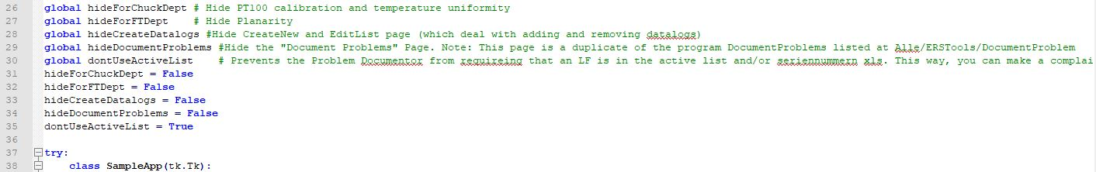
Different versions of program
Different features of the program can be turned on or off easily
Make a copy of the program, then activate/deactivate the features you want to be seen

Slide 6
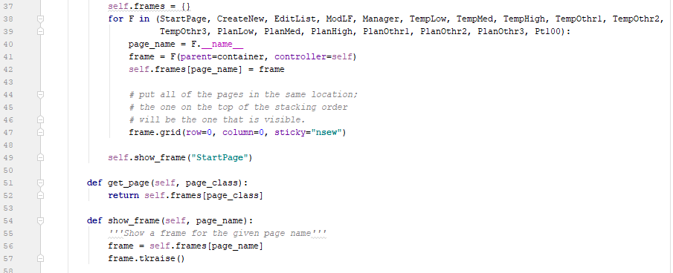
Referencing other classes/pages, showing other pages
Called each time a reference to
another page is made
If you add a page, you need
to add to the “for F in” list

Slide 7
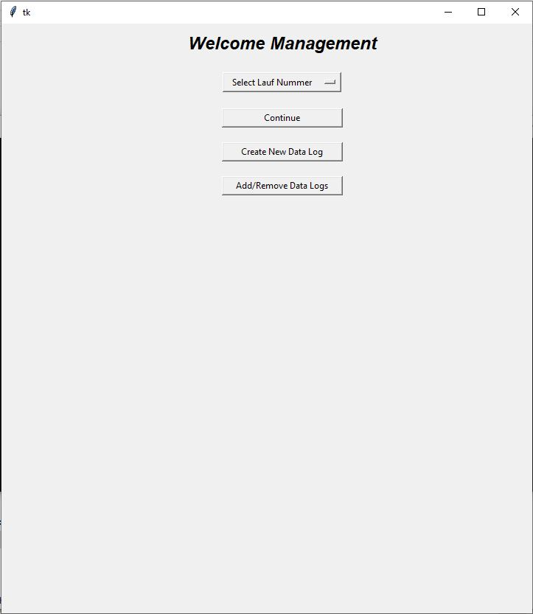
“Start Page”

Slide 8
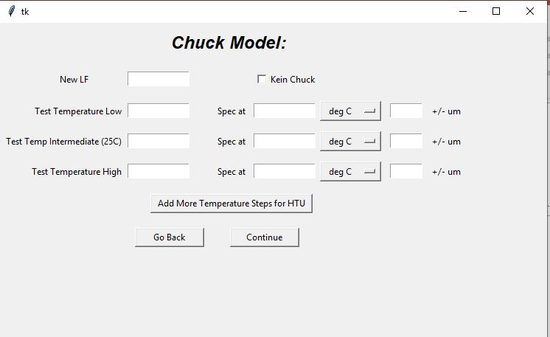
“Create New Data Log”
1. Enter Lauf Number and test temperatures
(able to add up to 6 temperatures for HTU)
2. Press Continue
Seriernnummern spreadsheet is searched for
LF number
Specifications are then automatically added
Specifications able to be changed for now, but
errors should be corrected in spec spread sheet
(more on this later)
3. Press save

Slide 9
“Create New Data Log” / CreateNew class
Seriennummern spreadsheet is parsed to extract chuck type (LF must exist in this sheet in order to continue)
R:\Endtest\30_Seriennummern\Seriennummern.xlsm
Matched to spec sheet to return specs
X:\ERSTools\EndtestData\specs.xlsx
New data log saved to “active_list”
X:\ERSTools\EndtestData\active_list.xlsx
Active list is continually updated by program to track completion status
New directory created when save successful
R:\Endtest\10_Dokumente\XXXX_ERSXXXX
R:\Endtest\10_Dokumente\XXXX_ERSXXXX\data
Files in R:\Endtest\10_Dokumente\XXXX_ERSXXXX\data
Ref.xlsx: this is the active same as a single row from the activelist, however ref.xlsx is not updated after it is created
Other xlsx files: contain data for individual tests (e.g. planarity at X degrees, or temperature uniformity at X degrees)
First row is #1 measurement, second row is #2 measurement (very straight forward)

Slide 10
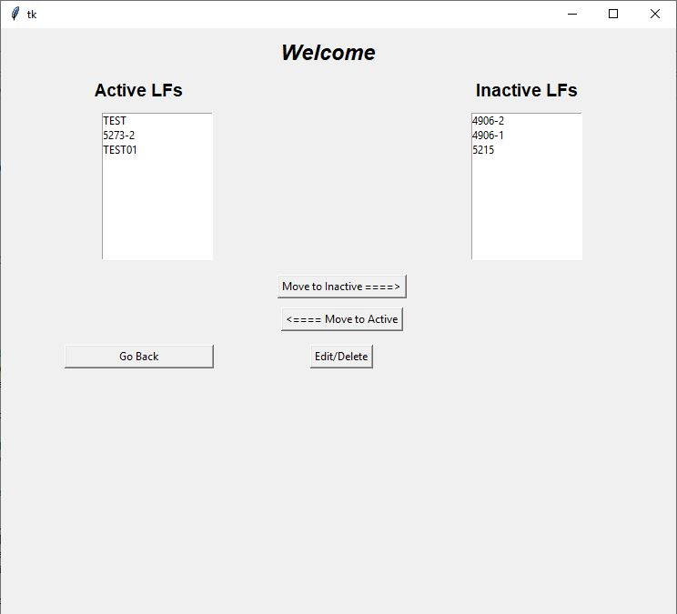
“Add/Remove Datalogs” / EditList Class
Only “Active LFs” are shown on the drop down menu
“Move to Inactive” after an order has shipped
Use “Edit/Delete” delete and recreate an LF if needed

Slide 11
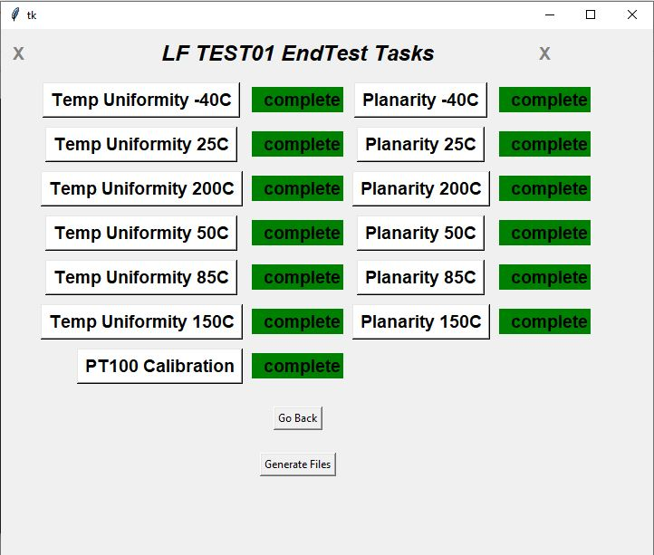
“Continue” / Manager Class
After selecting LF number and pressing “continue,” you
come to this page
Only Planarity is shown for Chuck Department (if configured as shown pg.5)
Only Temp Uniformity and PT100 calibration shown for
Nuhan/EndTest (if configured as shown pg.5)
Chuck department only (if configured as shown pg.5)
End Test department only (if configured as shown pg.5)

Slide 12
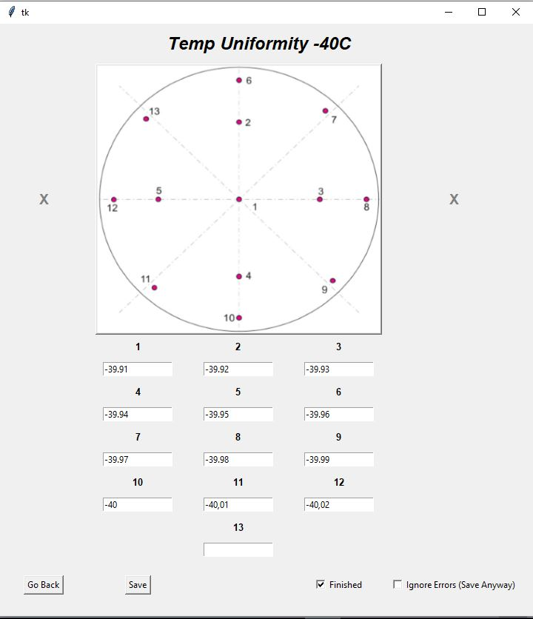
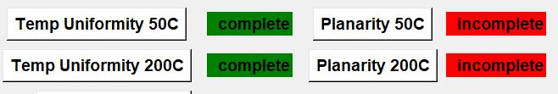
Data Entry
Enter data
Press save
After pressing save, all values are checked
to see if they are in specifications
Check “Finish” before save
Updates the color in the manager from red to
green

Slide 13
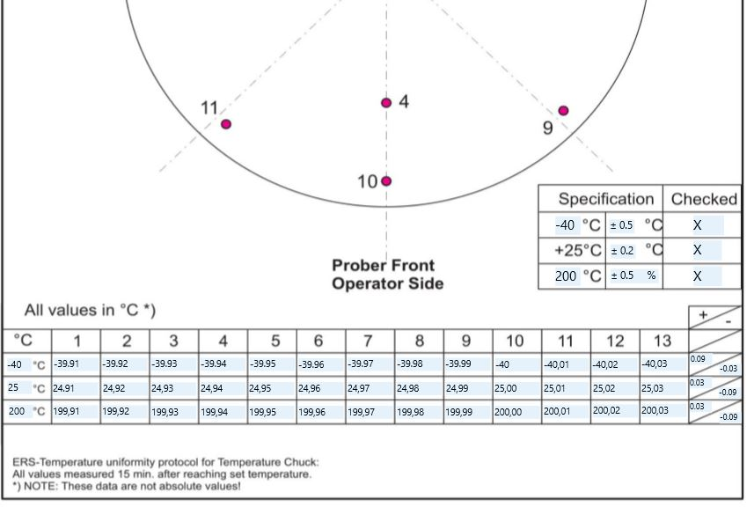
Generating Files
After data entry is complete, create documents
by pressing “Generate Files”
Files at : R:\Endtest\10_Dokumente\XXXX_ERSXXXX

Slide 14
Making Changes
Changing Specs
Update spec sheet X:\ERSTools\EndtestData\specs.xlsx
Legend for spec sheet found at X:\ERSTools\EndtestData\Documentation\specs_legend.xlsx
Changing code/troubleshooting
If troubleshooting an LF already completed, change the name of the folder that contains real data in "//fileserver/produktion/Endtest/10_Dokumente/“. Change the name so that you don’t overwrite data
Always back up. Keep track of other locations on server where you put shortcuts.

Slide 15
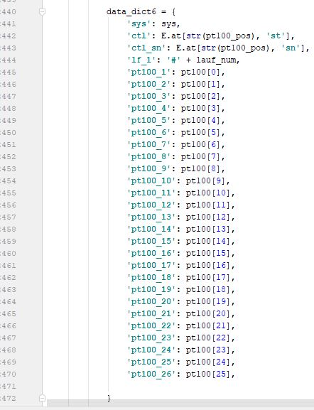
Making changes to documents
Fillable PDFs are created from an Open Office format document
You cannot change the fields in Word. You NEED Open Office
https://smallbusiness.chron.com/create-openoffice-fillable-forms-74857.html
Green text in data dict = names of fields in Open Office
Note: Fields in open office do not have a border in the completed documents.
I suggest using a border while working on the document formatting, and
then removing the border later

